Slide 1
🌾 AgriDrone Optimization — Final Defense
BRICS RUSSIA FUTURE SKILLS & TECH CHALLENGE 2025
Individual Participant: SARFO KUSI, GHANA
Category: UAV Agricultural Sprayer CFD Optimization
Software Used: SolidWorks | Flow Simulation | Python CFD | KeyShot | Excel

Slide 2
1️⃣ Project Overview
Objective:
• Develop optimized agricultural UAV nozzle for uniform and efficient spraying.
• Validate via SolidWorks CFD and Python analysis.
• Evaluate ROI and sustainability for scalable farming impact.

Slide 3
2️⃣ Design & Prototyping (Module A)
• 3 Nozzle Variants: 0.5 mm, 1.5 mm, 2.5 mm orifice.
• Designed in SolidWorks — each tested under identical pressure and height (4 m).
• Assembly: Pump, Tank, 4-Nozzle Array, Drone Mount.

Slide 4
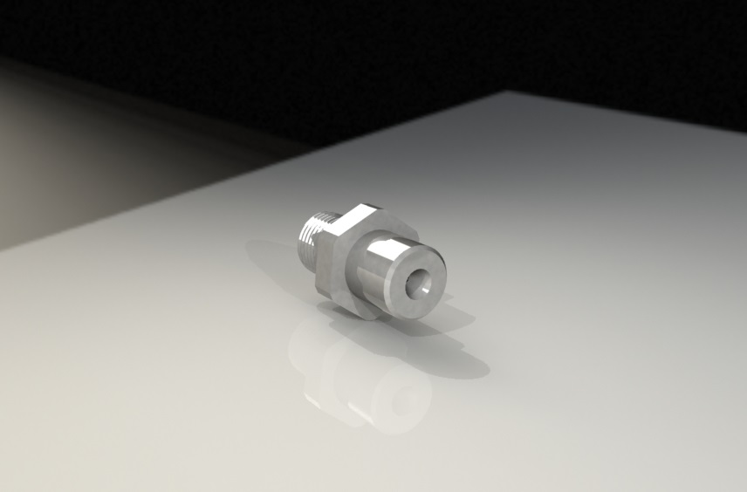

Slide 5
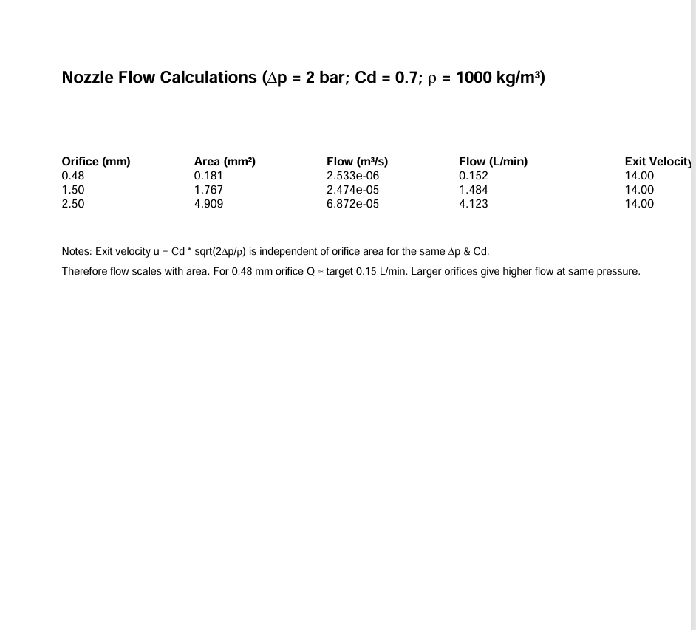

Slide 6
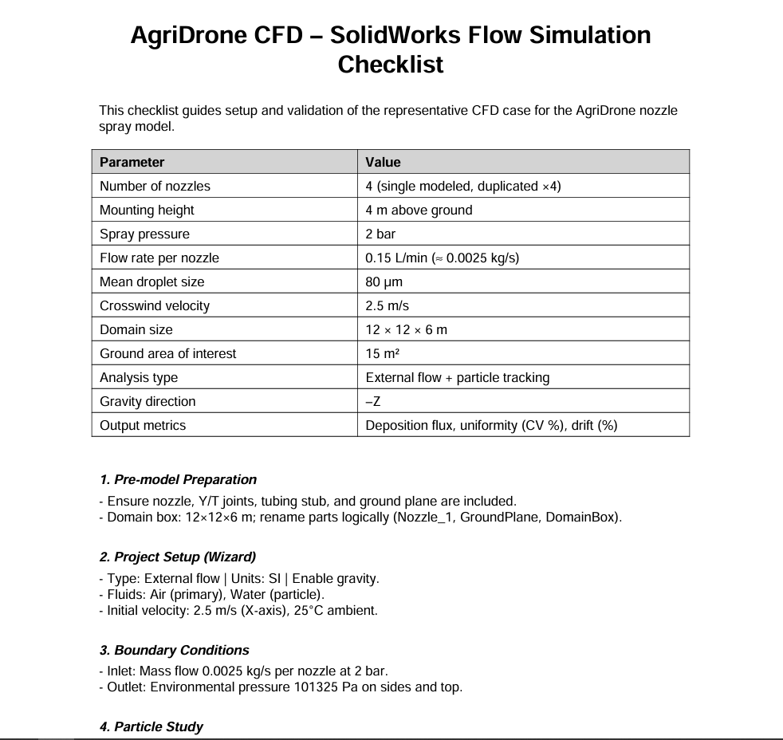

Slide 7
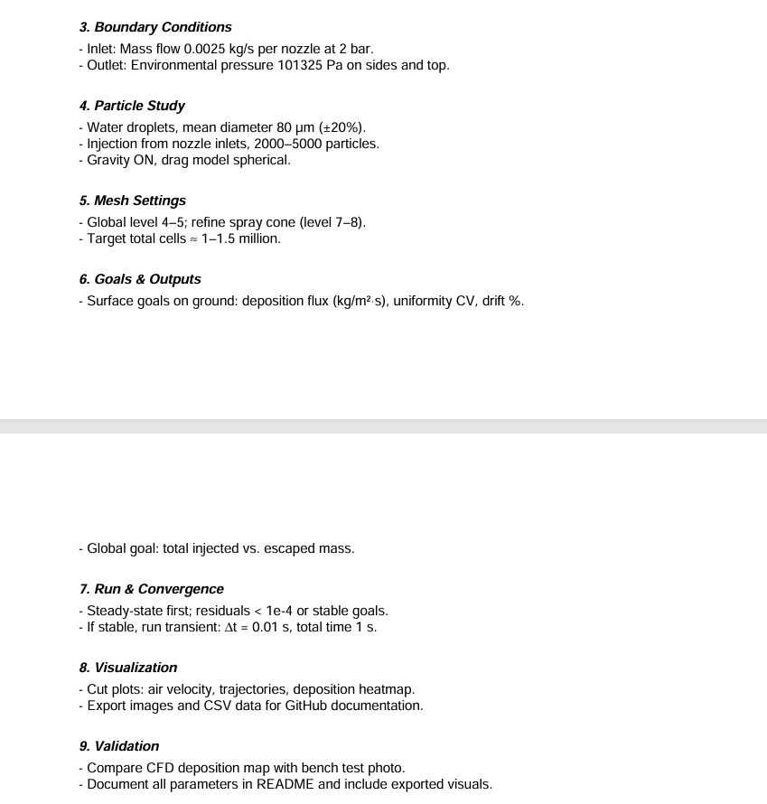

Slide 8
3️⃣ Testing & Simulation (Module B)
• CFD simulated using SolidWorks Flow Simulation.
• Analyzed pressure drop, droplet velocity, spray pattern.
• Python code post-processed data to visualize performance.

Slide 9
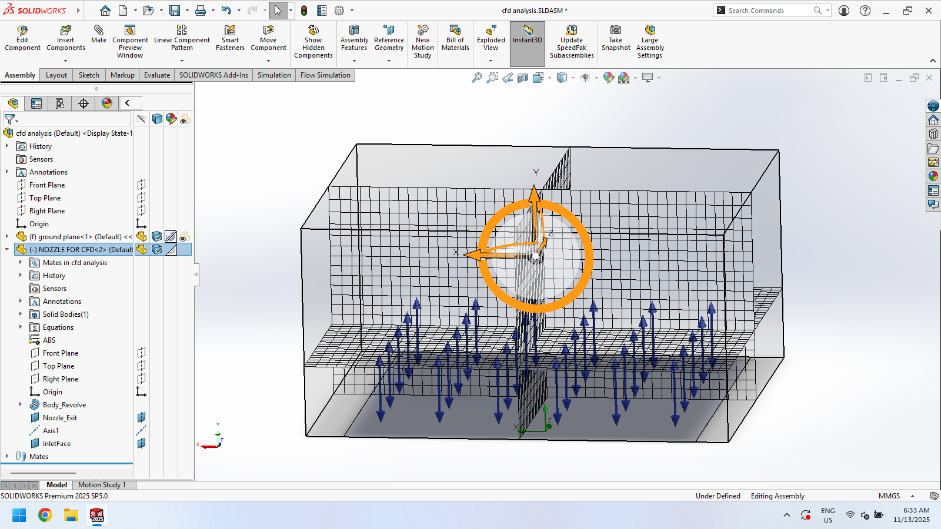

Slide 10
4️⃣ Economic Efficiency (Module C)
• Total system cost: ~$1,780
• Annual return: ~$320
• Payback: 1.8 years
• ROI (3 years): ~53%
Conclusion: Investment viable and cost-effective for small-scale farms.

Slide 11
5️⃣ Presentation & Defense (Module D)
• Project supported by AMP CAD South Africa (Simulation trial access).
• Rendered and animated in KeyShot for visual demonstration.

Slide 12
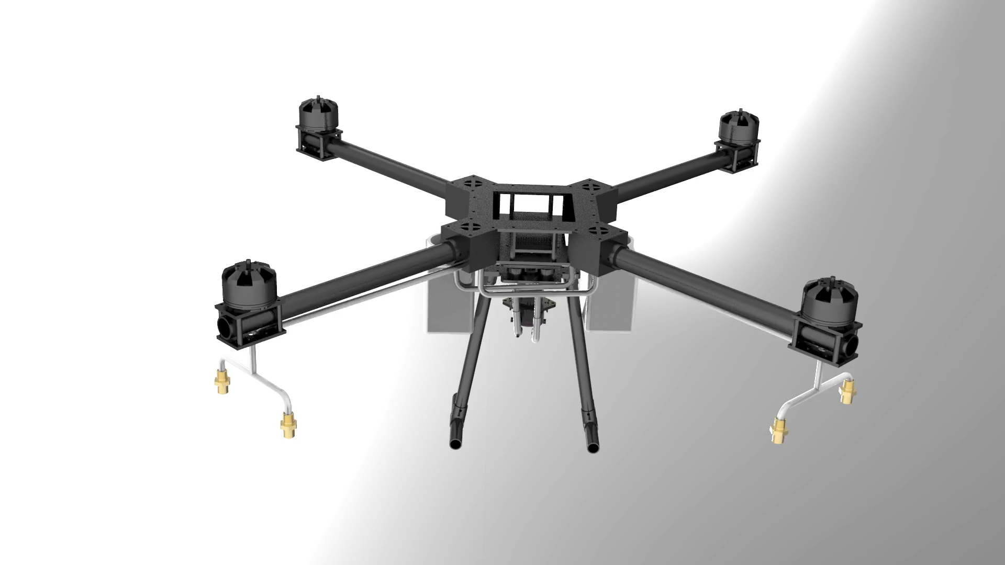
ANMATION

Slide 13
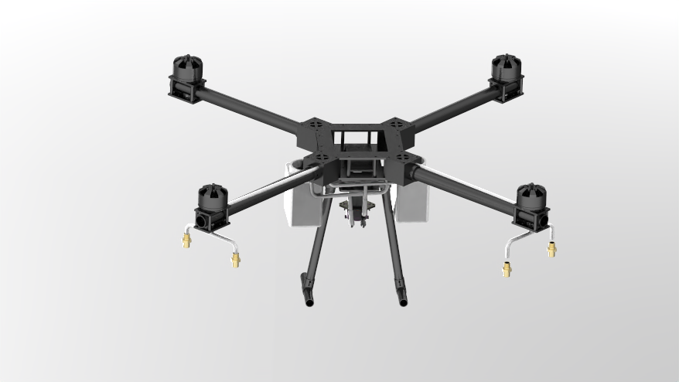

Slide 14
6️⃣ Conclusion
• Achieved target: uniform spraying and optimized nozzle flow.
• Provided both engineering and economic models.
• Demonstrated complete workflow — from design to decision support.
Future Work:
• Integrate electronics for real-time flow sensing.
• Scale-up for multi-nozzle drones.
Thank You 🌿

